Slide 1
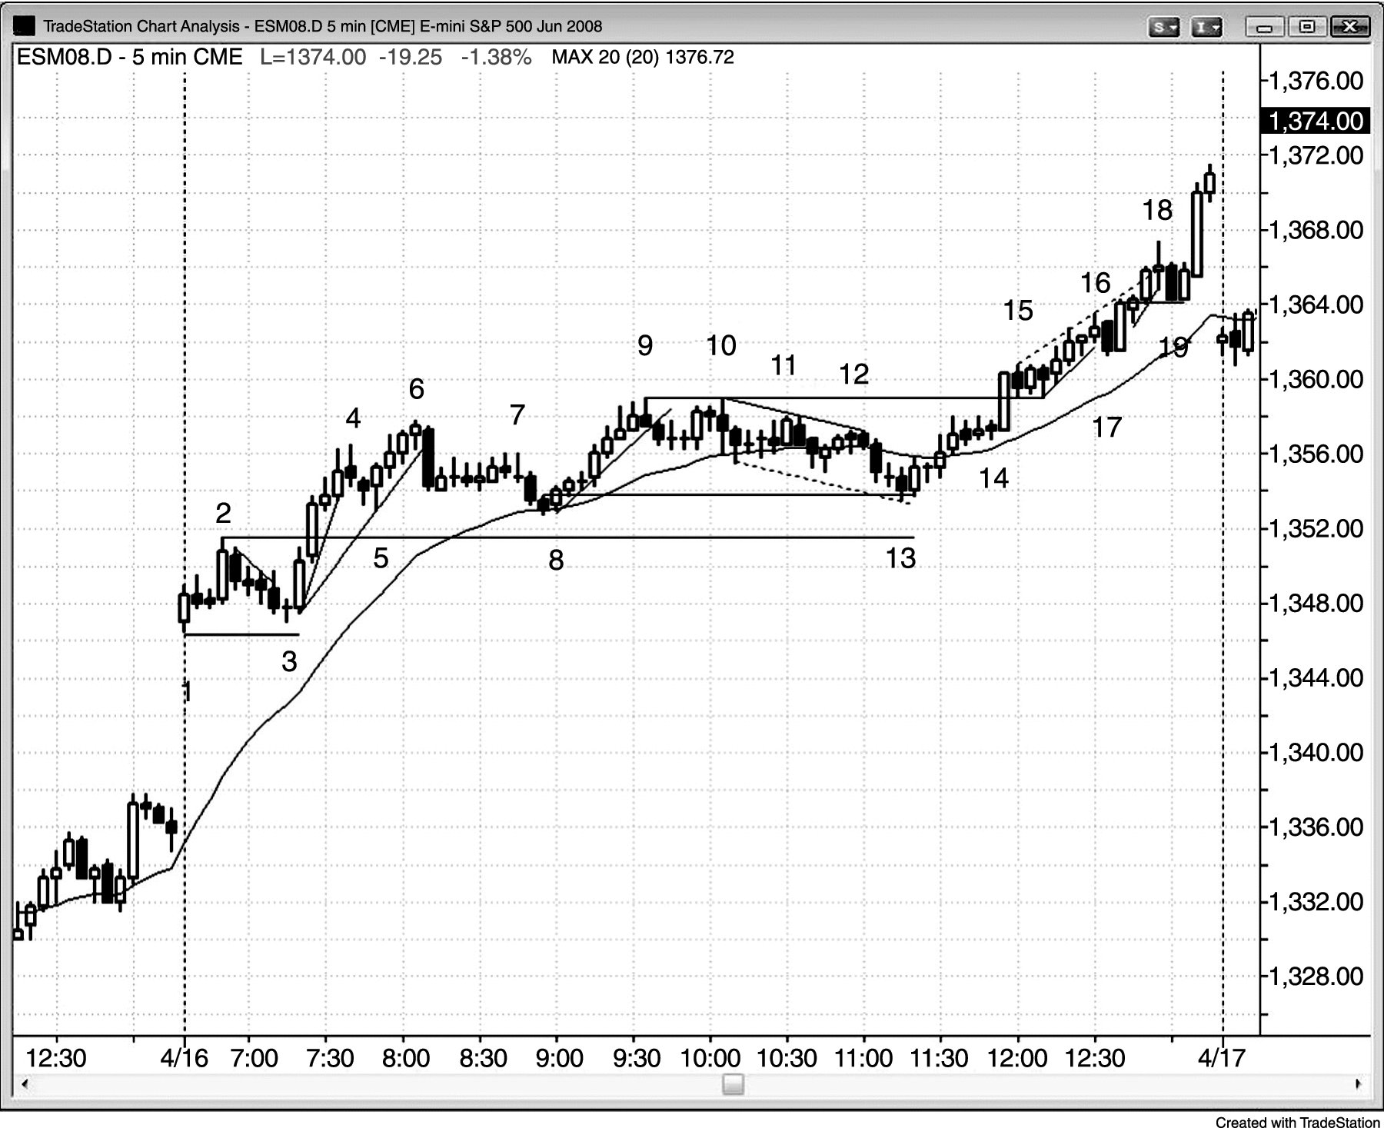
FIGURE 19.1 Big Gap Up on Bull Day

Slide 2
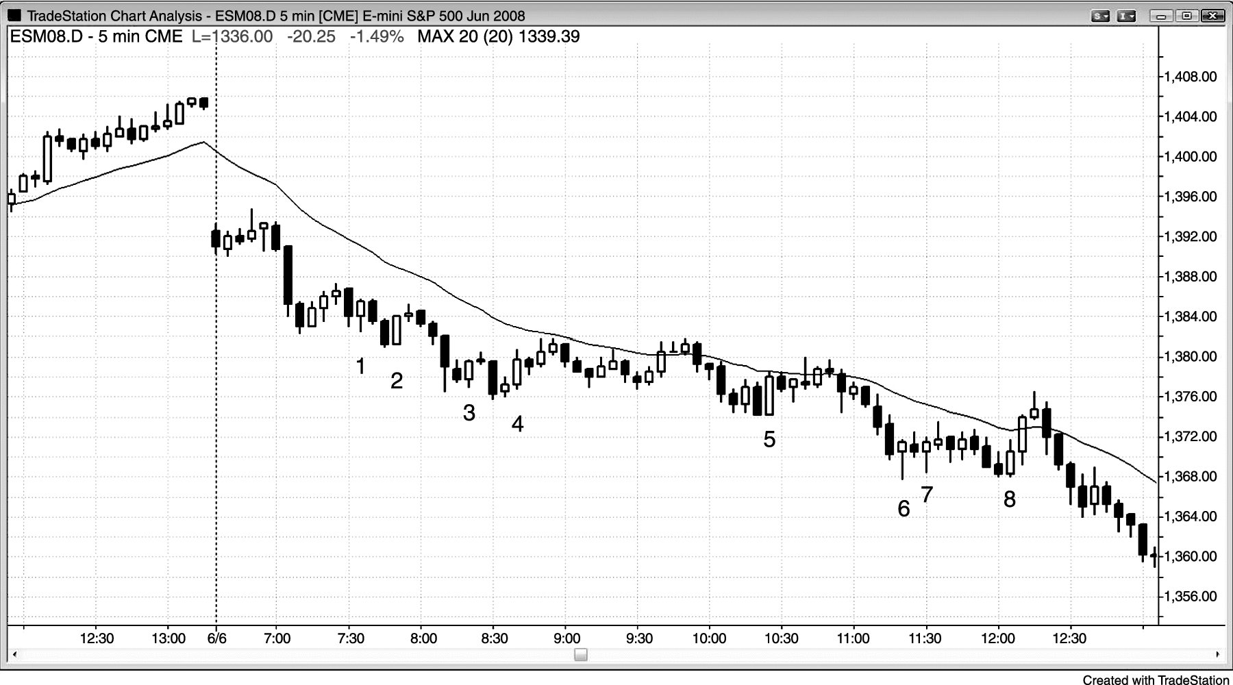
FIGURE 19.2 Most Reversals Fail on Trend Days

Slide 3
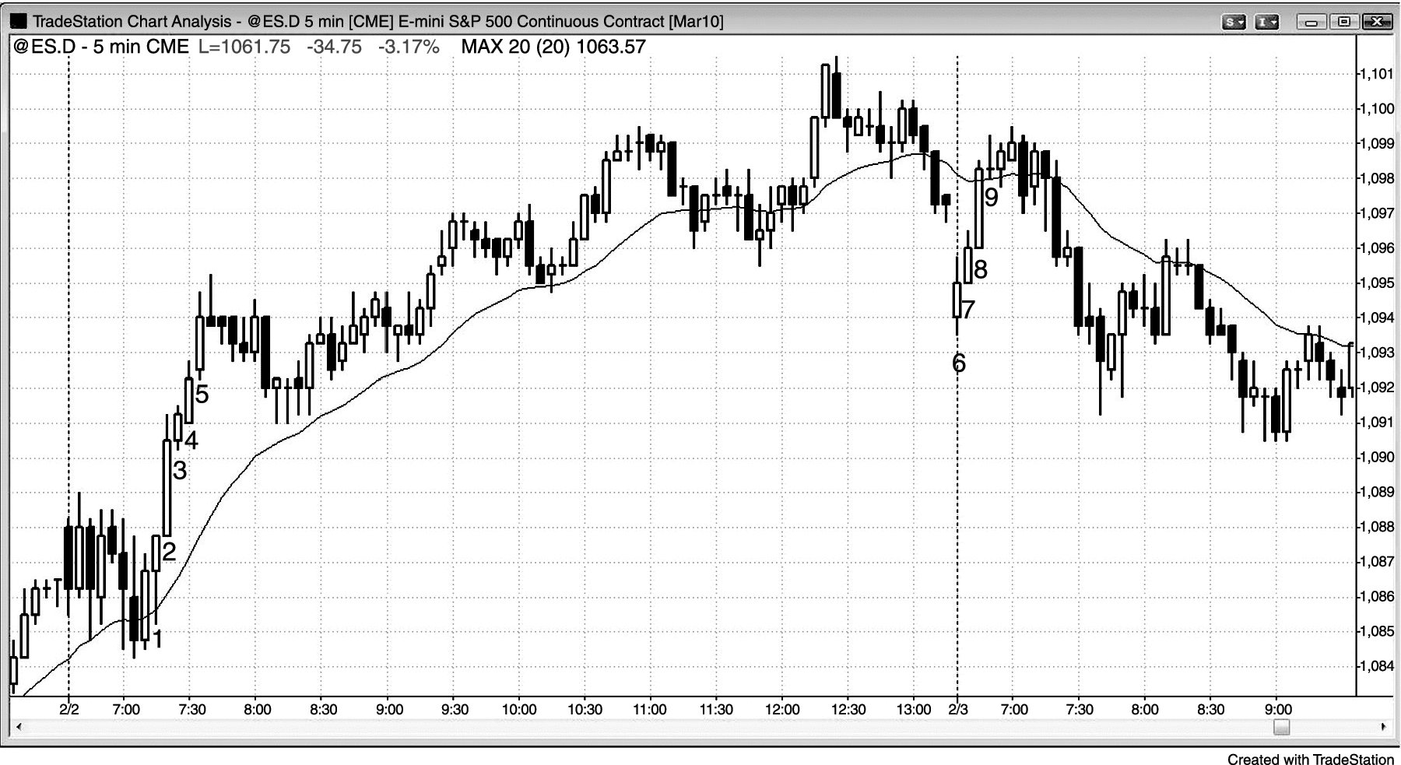
FIGURE 19.3 No Pullbacks Means the Trend Is Strong

